Slide 1


Slide 2
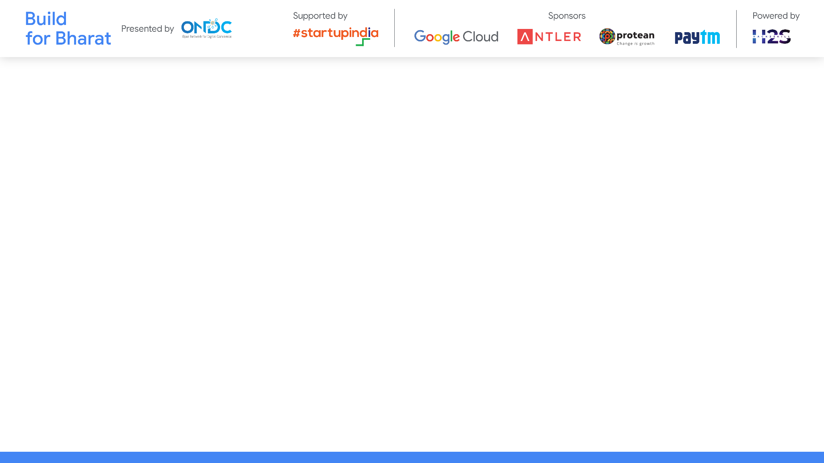
Team Name: Code Sentinels
Team Leader Name: Nupriya Saxena
Team Member Names: Gitel Panwar, Jasmin Hirani, Aqsa Shoeb
Problem Statement Category: Scalable Solution
Problem Statement: Price Optimization Engine

Slide 3
Architecture of Prize Optimization Model
Decision Tree Regression Model: Outline the use of decision tree regression as the modeling technique for optimizing prices.
Overview:
Decision tree regression is a supervised learning algorithm used for solving regression problems.
It works by recursively partitioning the feature space into smaller regions and fitting a simple model (e.g., mean) in each region.
The model predicts continuous target variables based on the feature values.

Slide 4
Architecture of Prize Optimization Model
Components:
Data Collection:
Gather historic customer data from the Brazilian ecommerce giant, including features such as customer demographics, purchase history, product preferences, etc.
Ensure data is representative and covers a diverse range of customers and transactions.
Data Cleaning and EDA:
Perform data cleaning to handle missing values, outliers, and inconsistencies.
Conduct exploratory data analysis (EDA) to gain insights into the distribution, patterns, and relationships within the data.
Visualize key features and relationships using histograms, scatter plots, and correlation matrices.

Slide 5
Architecture of Prize Optimization Model
Feature Selection:
Identify relevant features that may influence pricing decisions and customer behavior.
Consider factors such as product attributes, customer demographics, purchase frequency, etc.
Model Training:
Split the dataset into training and testing sets.
Train the decision tree regression model on the training data.
Utilize algorithms such as CART (Classification and Regression Trees) to construct the decision tree based on feature splits that minimize the variance of the target variable.

Slide 6
Design of Prize Optimization Model
Overview: Discuss key design considerations that guided the development of the prize optimization model.
Factors Considered:
Objective: Highlight the primary goal of increasing sales and revenue through price optimization.
Model Selection: Justify the choice of decision tree regression as the modeling technique, considering its interpretability and ability to capture nonlinear relationships.
Feature Engineering: Describe any feature engineering techniques employed to enhance model performance, such as creating new variables or transforming existing ones.

Slide 7
Design of Prize Optimization Model
Hyperparameter Tuning: Explain the process of tuning hyperparameters of the decision tree regression model to optimize performance and avoid overfitting.
Integration Strategy: Outline plans for integrating the marketing funnel dataset with customer data, including data preprocessing and alignment of variables.

Slide 8
Customization & deployment options
Interpretability: Decision trees are easy to understand and interpret, making them suitable for explaining the model's decision-making process to non-technical stakeholders. The tree structure represents a sequence of binary decisions based on feature values, which can be intuitively interpreted.
Handling Non-linearity: Decision tree regression can capture nonlinear relationships between input features and target variables. Unlike linear regression, which assumes a linear relationship between variables, decision trees can model complex interactions and patterns in the data.
Feature Importance: Decision trees provide a measure of feature importance, indicating the relative contribution of each feature to the model's predictions. This information can help identify the most influential features and prioritize them for further analysis or feature engineering.

Slide 9
Customization & deployment options
Real-time Inference: In this deployment option, the model is integrated into an application or system, and predictions are generated in real-time as new data becomes available. This approach is ideal for applications that require immediate responses, such as recommendation systems or fraud detection.

Slide 10

Test cases & data (as applicable) against which the eval criteria can be assessed
we want to help the company to solve the below listed business questions :
1) How number of orders changes when some sale is running on ?
2) How is the variability of the demand history ?
3) Are there any outliers that we can observe in the sales distribution
4) Are there any temporal patterns in sales behaviour that can be exploited?
5) Possible pricing issues that have escaped their attention
6) Are there any avenues to cross-sell/up-sell/bundle certain products?
7) Aspirations to suggest the company around the inventory management using historic data
8) Remedies to the issues identified above
*You can make a copy of the slides. Do not change the template branding.

Slide 11

Demonstrate working of the solution to the evaluation team
*You can make a copy of the slides. Do not change the template branding.

Slide 12
Important Links:-
GitHub Public Repository Link
Link to test cases and data files
*You can make a copy of the slides. Do not change the template branding.

Slide 13


